Slide 1


Salva Juan Soria
Oscar Martinez Romero
Camilo Mascarell Jorques

Slide 2


Index
Meet the team.
The product.
How we did it.
Our objectives.

Slide 3
Meet the team.
Oscar
Product owner – Organizing our work and taking care of the GIThub and Trello, also worked on the DataBase
Camilo
Developer – Mostly worked on the frontend and the website, along with other documentation (FOL)
Salva
Developer – Mostly worked on the backend and the English documentation

Slide 4
What were our objectives?
Desktop app
Made with Java and SQL
More specifically
Be able to connect to the database.
Be able to read and modify the information on the app, which then would change the information on the database, and vice versa.
Be able to do specialized queries about the information on the database.

Slide 5
Switch to Spanish!
Cambio a Español!

Slide 6
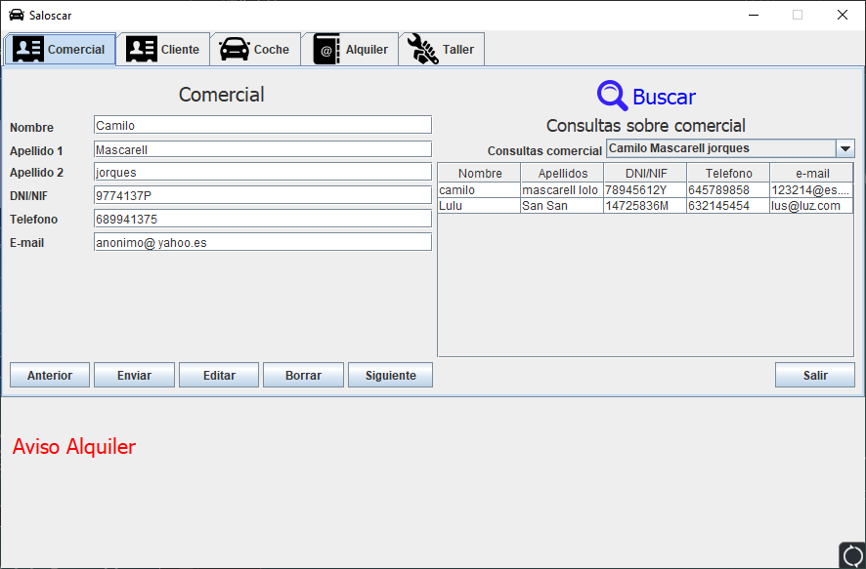
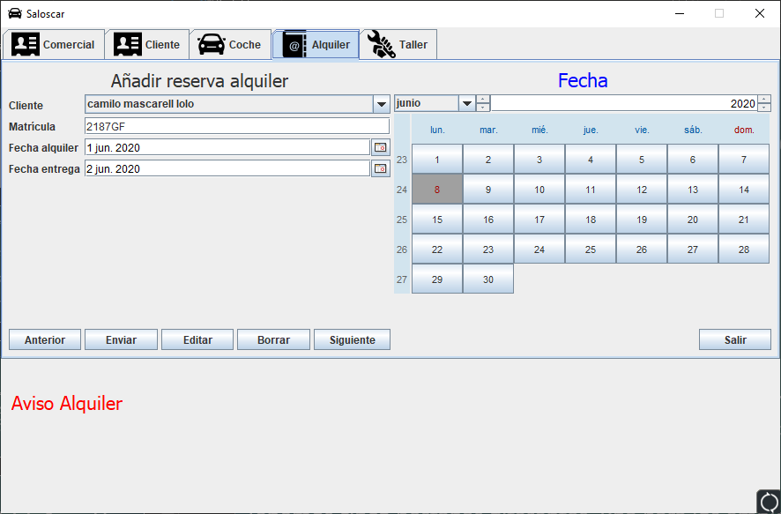
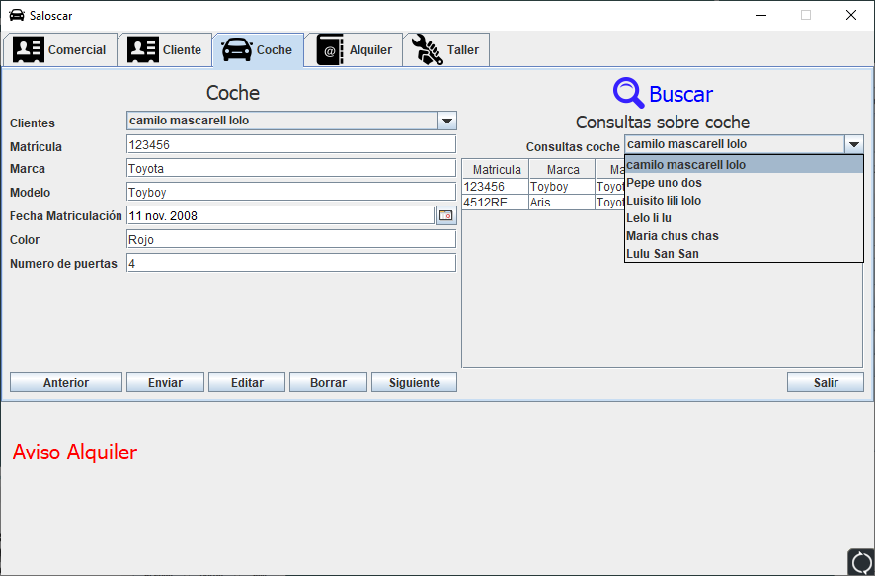
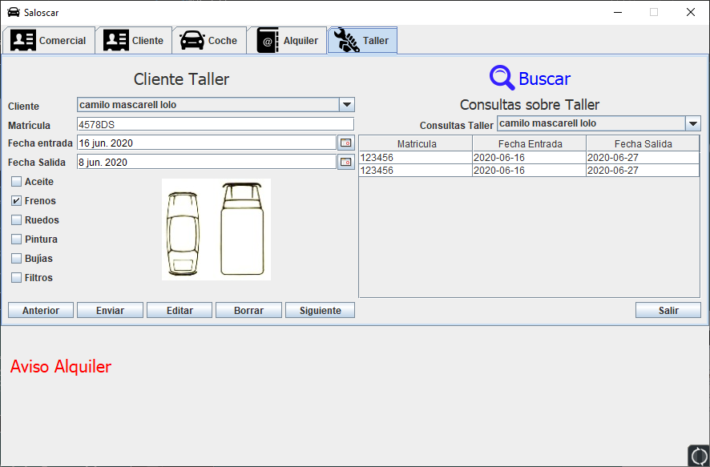
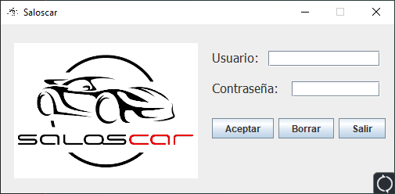
¿Cómo ha acabado el producto final?

Slide 7
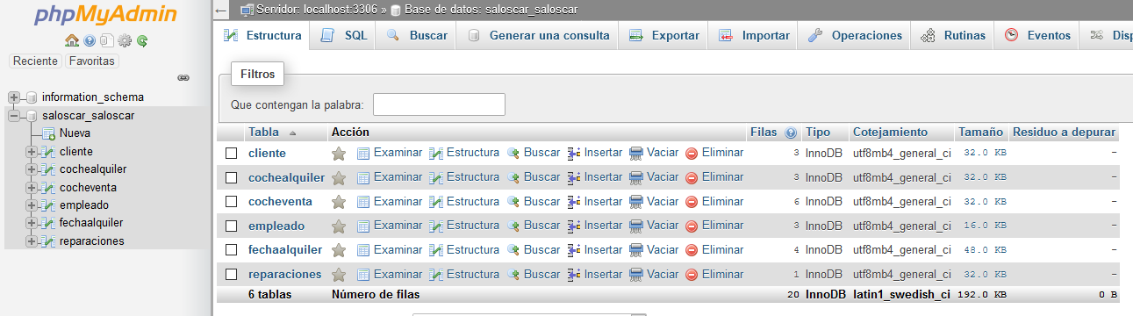
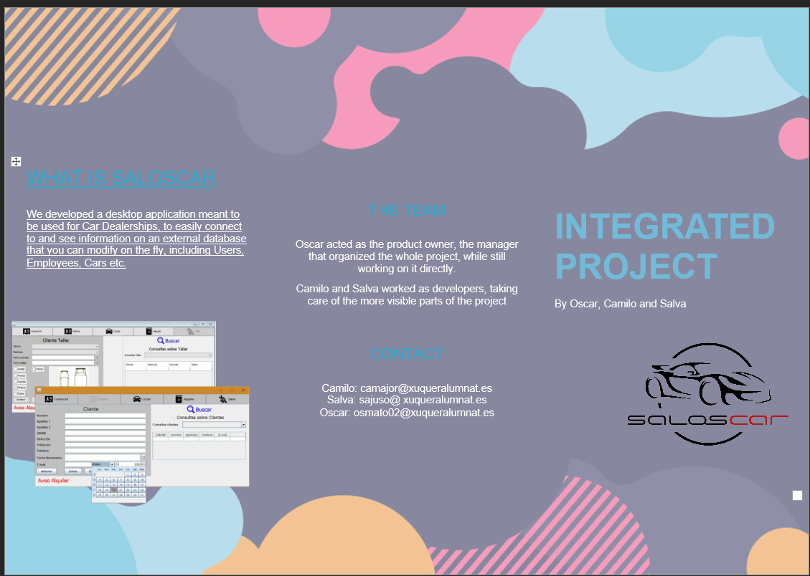
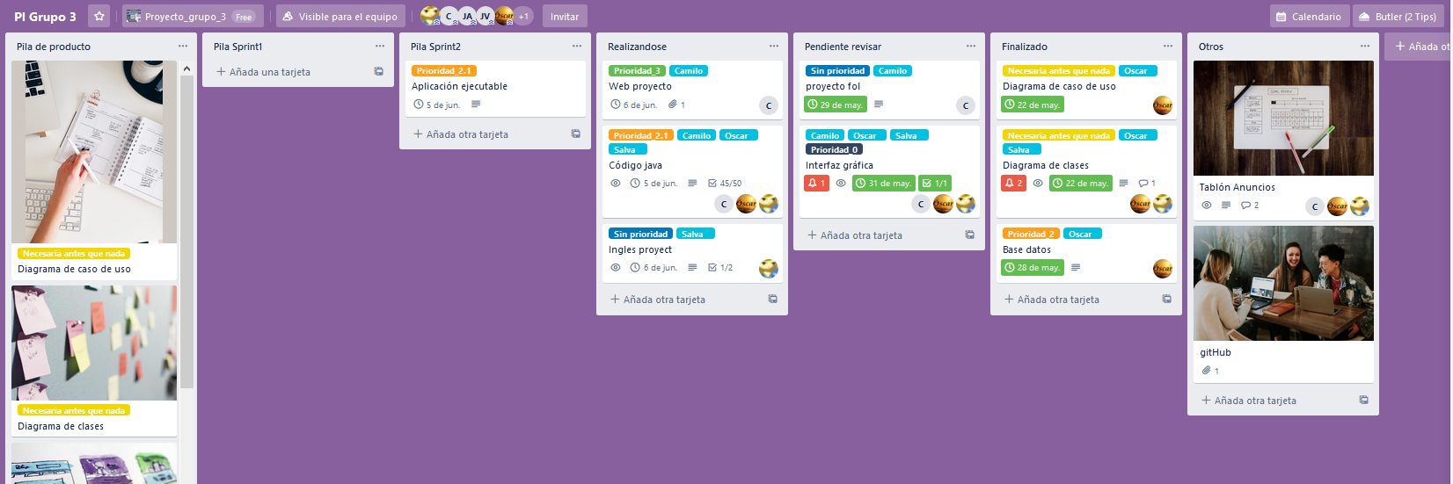
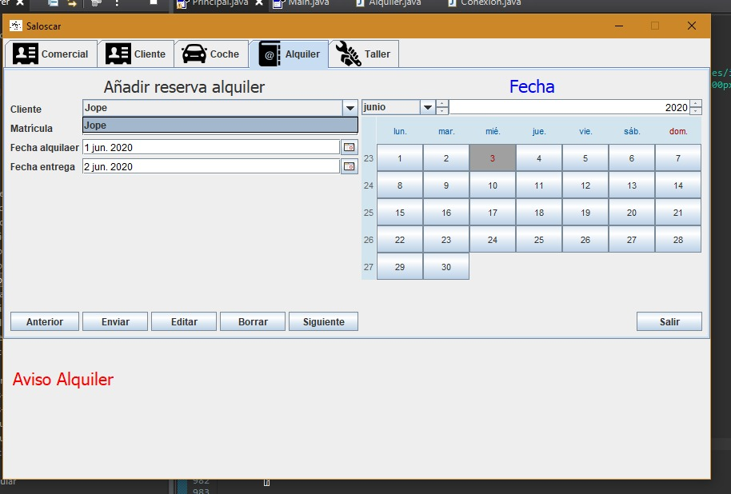
¿Cual ha sido el proceso?
Creamos el Trello y GitHub
Comenzamos a organizar las partes del proyecto separadas por asignatura y las asignamos a cada persona
Comenzamos a trabajar la interfaz y base de datos, además de otra documentación (Diagramas de uso y clases)
Comenzamos a trabajar en la programación y conexión a base de datos del programa, además de el material para ingles y FOL

